Slide 1
Chapter 6 & 7 Presentation
Amanda Homeyer, Niraj Bhakta, Richard Deleon, Sarai Camargo, McKay Wilkerson

Slide 2
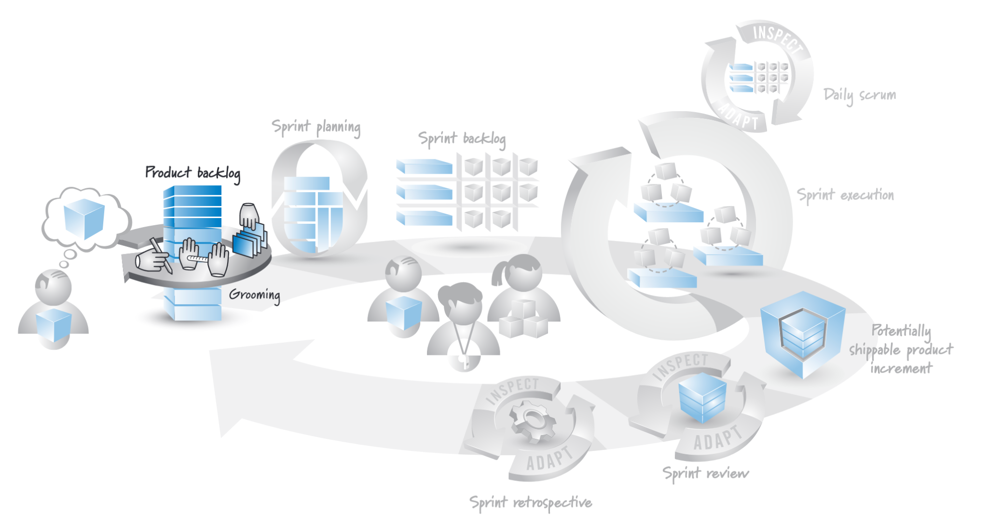
Chapter 6 - Overview
The product backlog plays a crucial role in the Scrum framework by providing clarity, transparency, and flexibility to the team and stakeholders. It enables the team to prioritize effectively, adapt to change, and deliver value incrementally, ultimately leading to the successful delivery of the product.
The product backlog is at the heart of the Scrum framework.

Slide 3
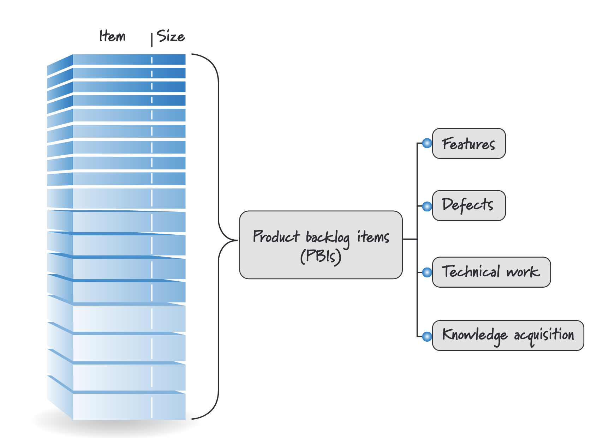
Product Backlog Items
Features (User Stories):
NEW: A login screen for a website
EXISTING: a more user-friendly login screen for an existing website
Defects:
Repairs
Technical Improvements
Knowledge-acquisition work

Slide 4
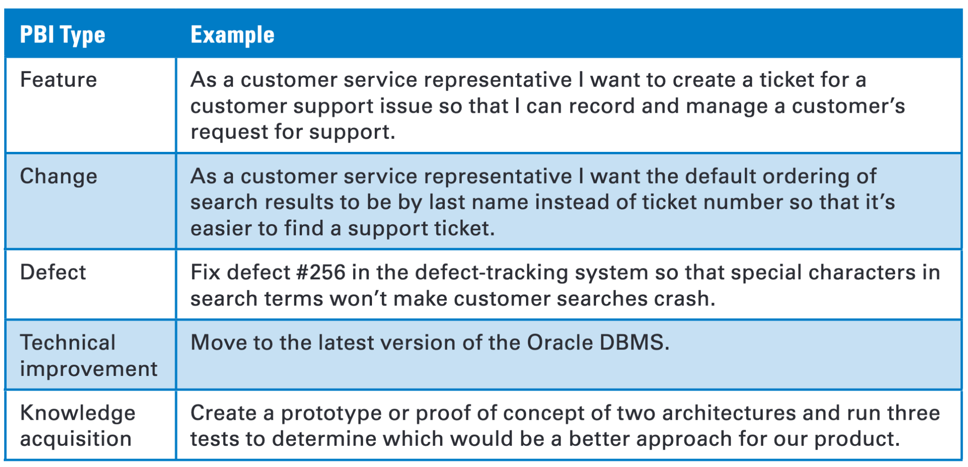
Example Product Backlog Items

Slide 5
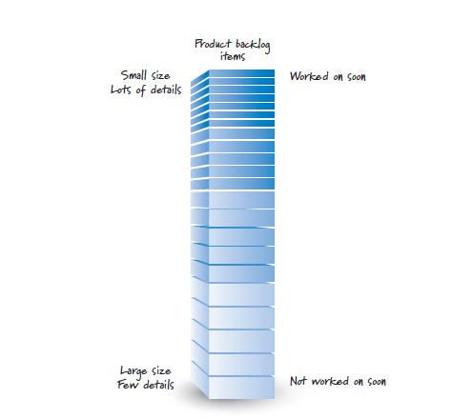
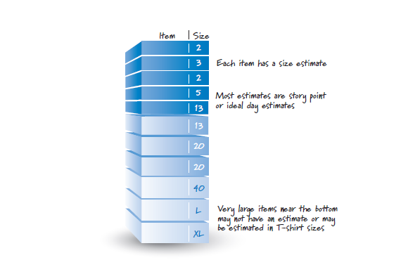
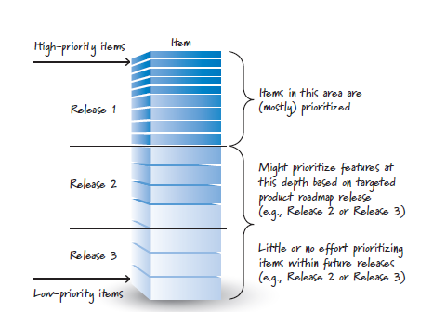
Good Product Backlog Characteristics

Slide 6
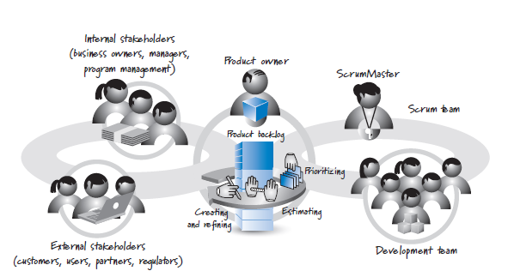
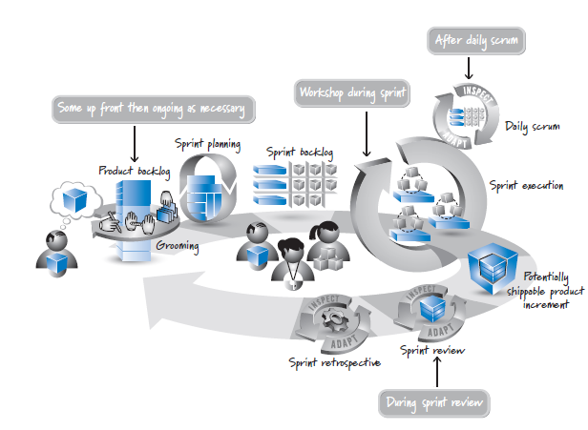
Grooming

Slide 7
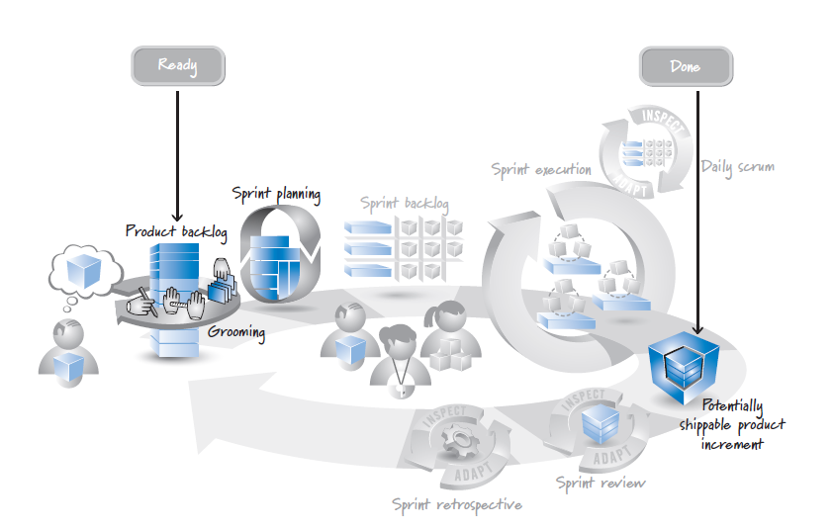
Definition of Ready
A checklist of the work that must be completed before a product backlog item can be considered to be in the respective state.

Slide 8
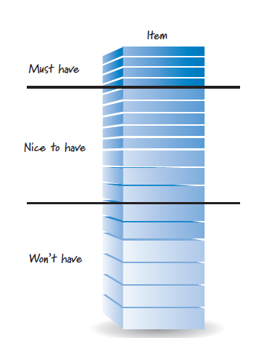
Flow Management
Release Flow Management
A line in the product backlog represents a release

Slide 9
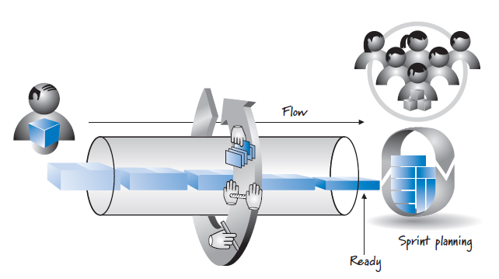
Flow Management
Sprint Flow Management
By the time an item flows out of the pipeline, it must be ready—detailed enough that the team can understand it and be comfortable delivering it during a sprint.

Slide 10
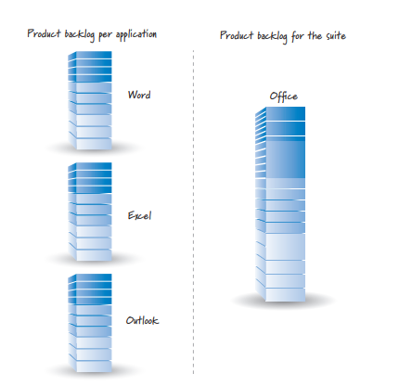
Which and how many product backlogs?
What is a product?
Large Products = Hierarchical Backlogs
Multiple Teams = One product backlog
One Team = Multiple products

Slide 11
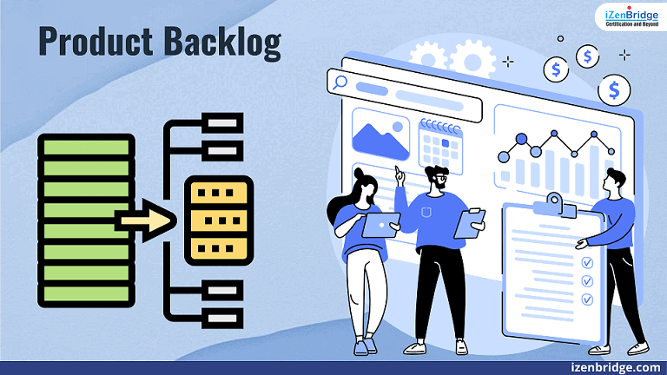
Closing
The importance of the product backlog in achieving efficient, adaptable value delivery in uncertain environments. Covers key aspects such as the content of the product backlog, the grooming process to enhance its characteristics, and the number of product backlogs to maintain

Slide 12
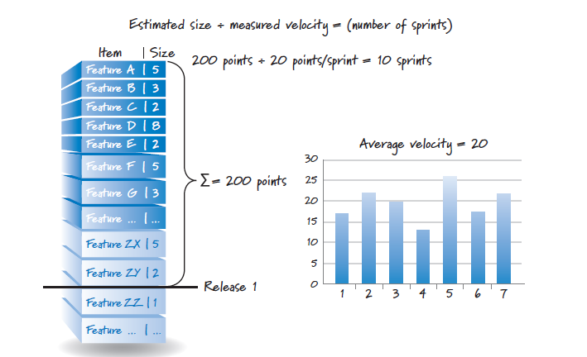
Chapter 7 Overview
Estimate the size of what we are building
Measure the velocity or rate at which we can get work done

Slide 13
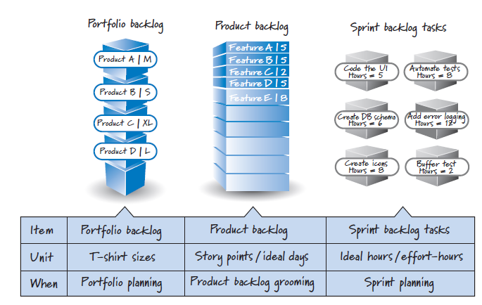
What and when we estimate

Slide 14
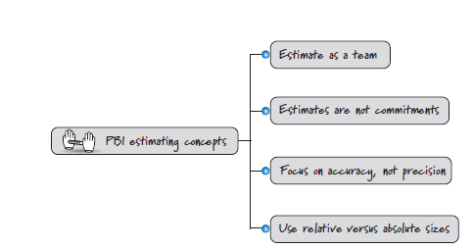
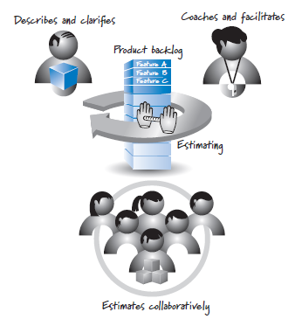
PBI Estimation Concepts

Slide 15
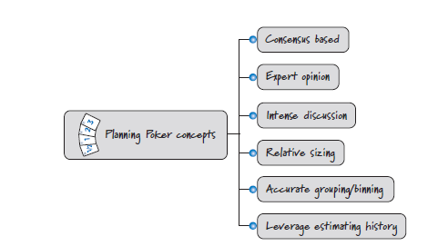
PBI Estimation Units

Slide 16
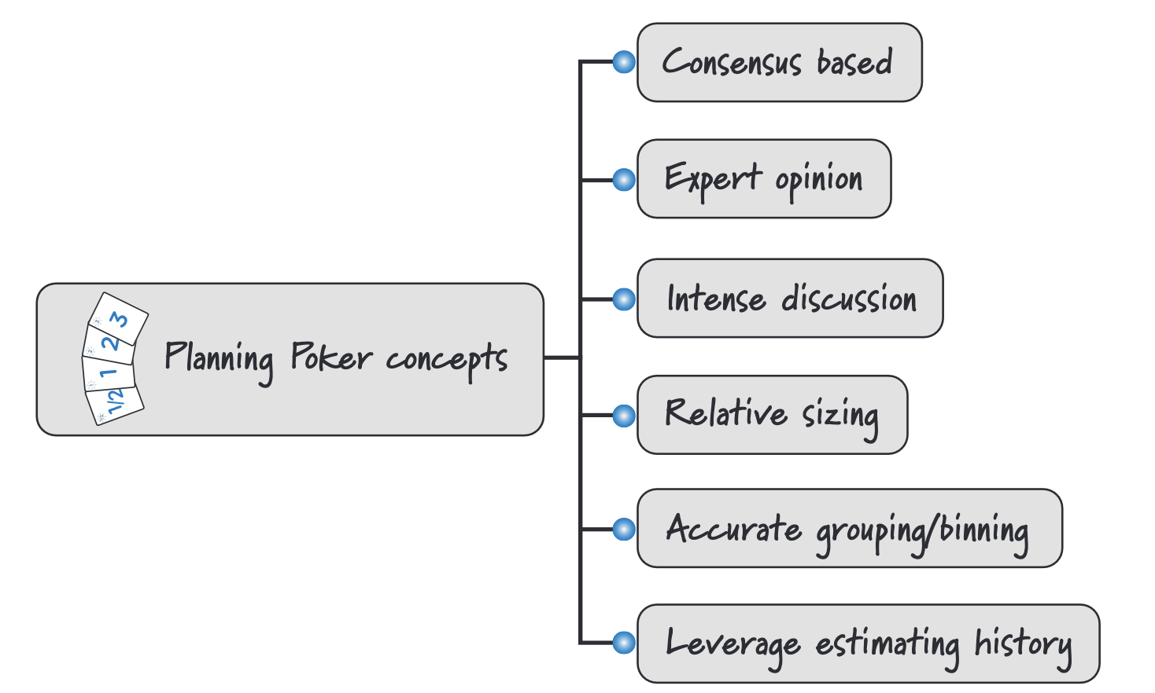
Planning Poker
Planning Poker is a collaborative estimation technique used in the Scrum framework to estimate the effort or relative size of user stories or tasks during sprint planning. It involves team members discussing and voting on the complexity or effort required for each item.

Slide 17
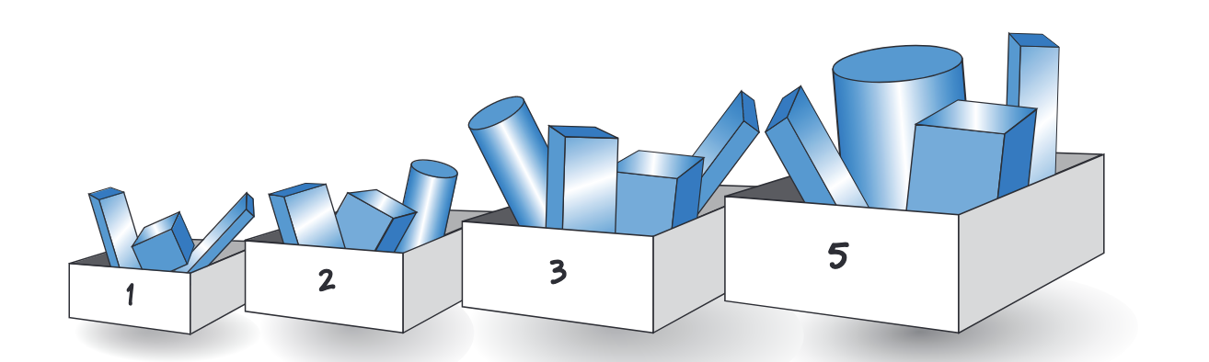
Estimation Scale
Estimation scale is a set of values used by team members to estimate the effort or relative size of user stories or tasks during the estimation process. The estimation scale helps standardize and simplify the estimation process, making it easier for team members to communicate and arrive at a consensus on the effort required for each item.
Fibonacci sequence:The sequence is based on the principle that as the size of the work increases, the uncertainty and complexity also increase non-linearly.

Slide 18
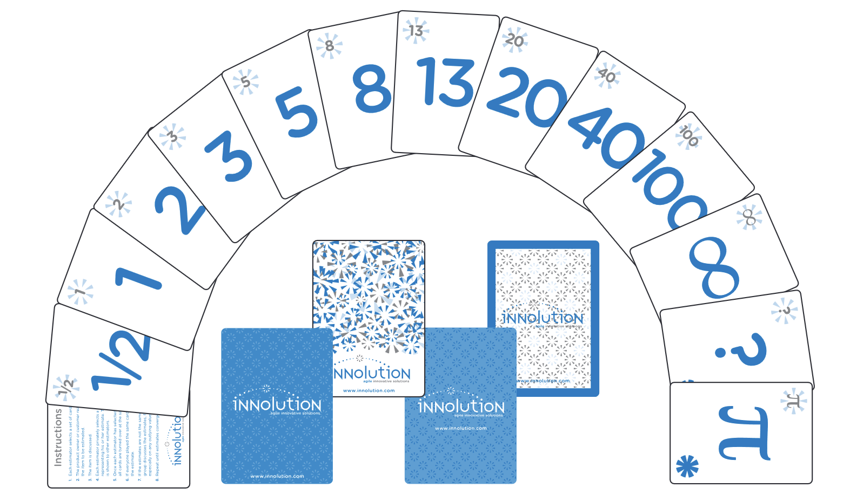
Innolution Planning Poker cards

Slide 19
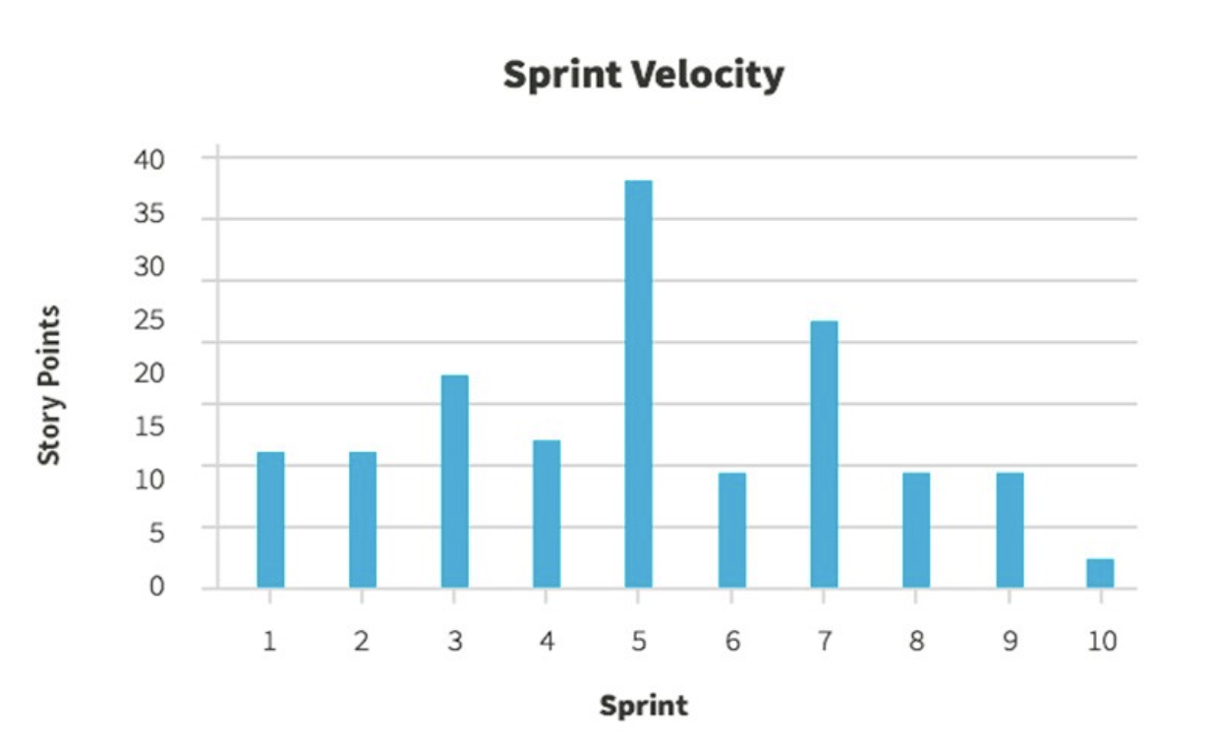
What is Velocity?
Velocity: quantity of work a team can accomplish in a sprint.
In the graph, sprint 5 was exceptionally productive, the team produced almost 40 story points. Their average velocity is around 10 story points.

Slide 20
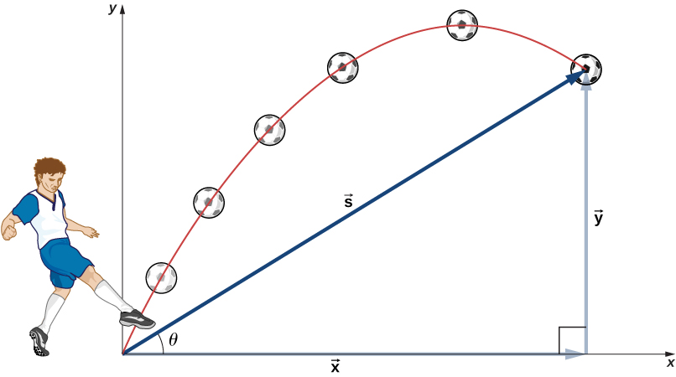
Calculate Velocity Range
Calculate the velocity for each sprint (usually the average of the story points completed across team members).
Find the standard deviation of the velocities to understand the variability.
Use the standard deviation to establish a range around the average velocity, which will give you the velocity range.

Slide 21
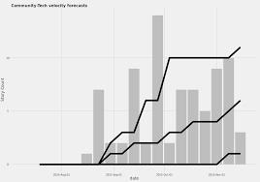
Forecasting Velocity
Forecasting velocity in agile development involves gathering historical data, analyzing trends, making adjustments for upcoming changes, estimating future velocity, and regularly reviewing and refining the forecast based on new data and feedback.

Slide 22
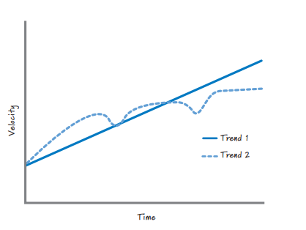
Affecting and Misusing Velocity

